Slide 1


Code Refactoring and Bug Fixing

Slide 2


About me
Name: Maskari Rachana Priya.
Qualification: Btech-CSE (III yr)
Work Experience: Fresher
Linkedin: https://www.linkedin.com/in/rachana-priya-maskari-3a540a246
Github: https://github.com/RachanaPriya-Maskari/Code_Refactoring_and_Bug_Fixing.git

Slide 3
Scenario:
A team of enthusiastic data scientists embarked on a mission to develop a Note Taking Application using Python, Flask, and HTML. However, their lack of experience in backend development has led to challenges in making the application fully functional. Recognizing your proficiency in backend development, you have been tasked with fixing the broken code and ensuring the application works seamlessly.
Task:
Refactor the existing codebase and ensure the proper functioning of the Note Taking Application. Document all identified bugs during the debugging process. Remember, the task is not about recreating the app from scratch. Your goal is to fix the already existing codebase and make the application work as intended.
More Details:
The application's home route contains a text field and a button. Users can add a note, and all the notes should be displayed as an unordered list below the text field on the same page.

Slide 4
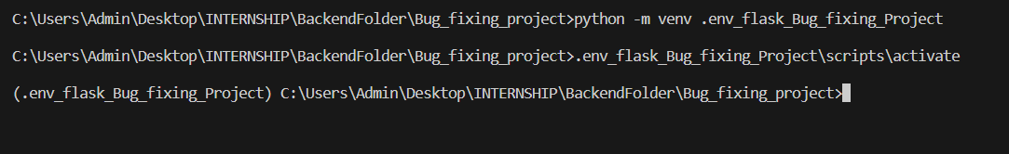
Mandatory steps:
On Visual Studio to fix bugs by using Python and Flask frame work.
Create a Virtual envirnoment in app folder by using this code.
Activate the virtual envirnoment by using this below code.
Run python app.py file to check how was web interface.

Slide 5
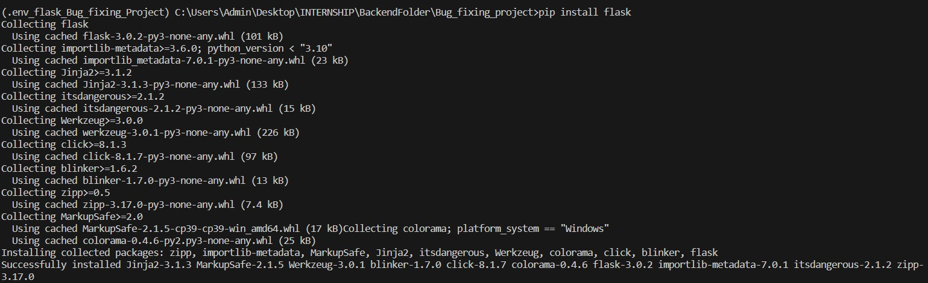
Install flask in Virtual environment

Slide 6
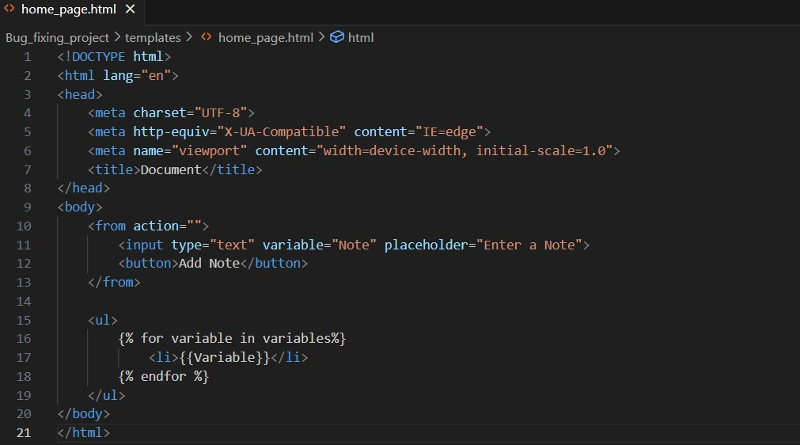
Before Fixing Bugs

Slide 7
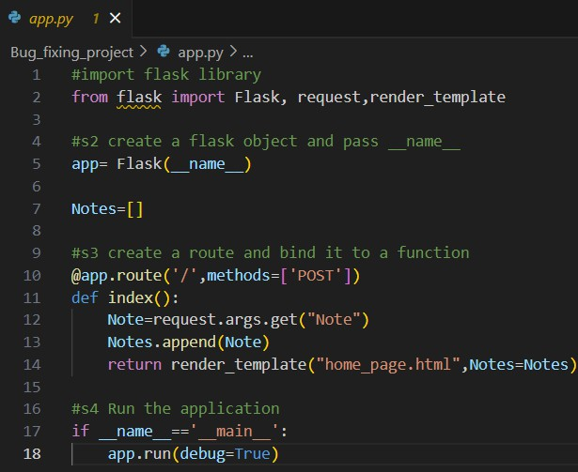

Slide 8
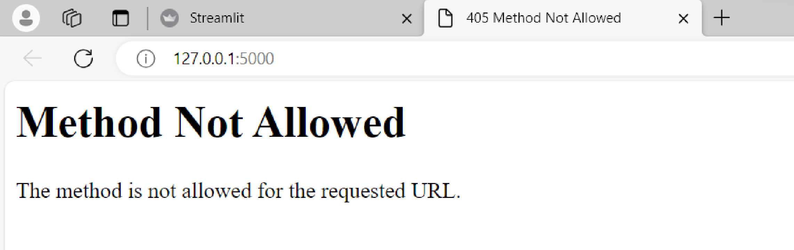
↓
In Http Response status code 405 means Method not allowed

Slide 9

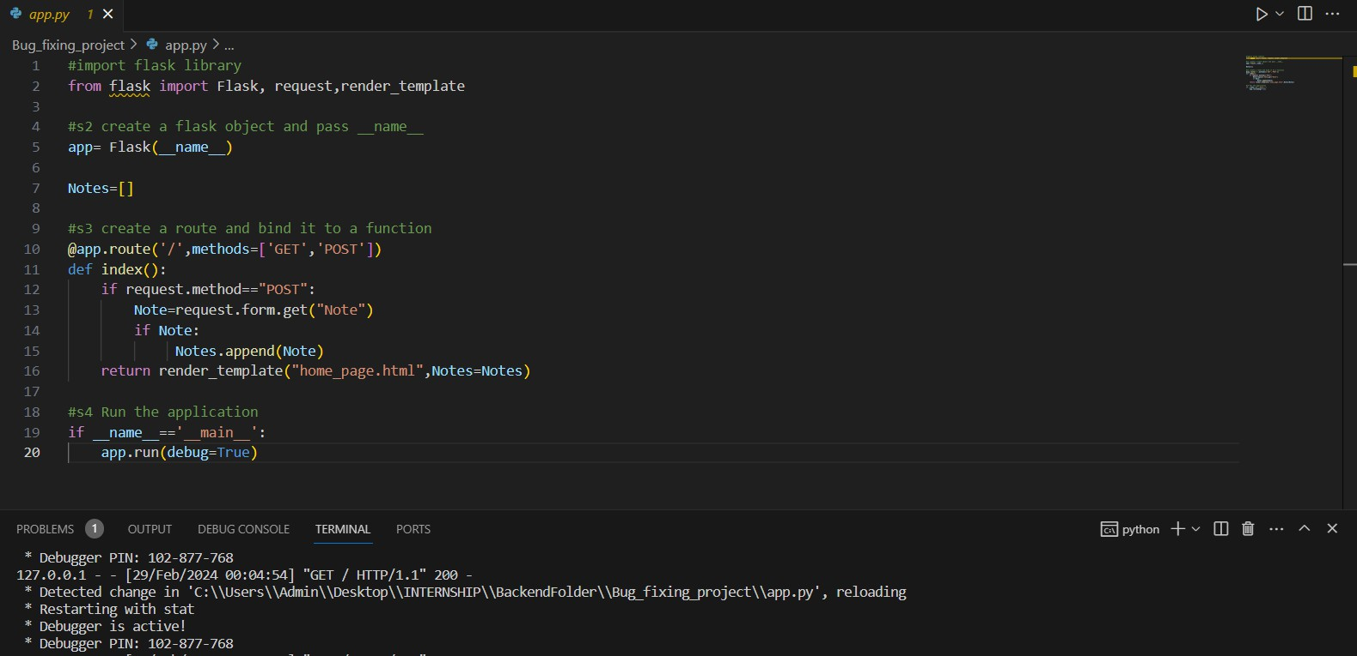
After Fixing The Bug

Slide 10
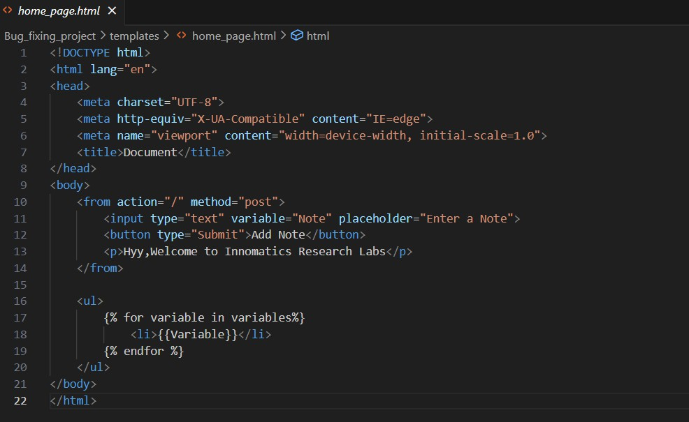

Slide 11
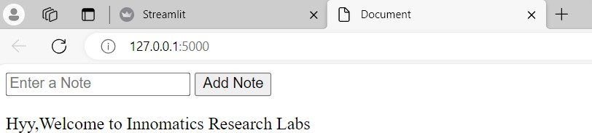

Slide 12

THANK YOU

